Slide 1
Co-Curricular Activities 2022 – 2023

Slide 2
Ledger Mentality
We are held to a higher standard.
It is about who and what we represent!
Romans 12:1 Therefore, I urge you, brothers and sisters, in view of God’s mercy, to offer your bodies as a living sacrifice, holy and pleasing to God-this is your true and proper worship.

Slide 3
The Ledger Way Core Values
Faith - We live our Catholic Faith in both word and action. We are disciples of Jesus Christ, called to be living examples of both faith and stewardship.
Learning -We are committed to excellence in education through personal growth and achievement. We strive to be inquisitive critical thinkers, problem solvers, and team players.
Respect - We treat God’s people with respect and kindness at all times. We acknowledge our differences, offering compassion, empathy and tolerance.
Leadership - We are devoted to a life of servant leadership, going above and beyond to serve the school, parish, community and world. We are responsible citizens and Christians committed to living life, promoting peace, and fostering social justice.
Community - We foster a welcoming, supportive, engaging and collaborative community that works in unison to overcome challenges and celebrate success. Together we honor our traditions and work in partnership to advance our institution.
Responsibility - We lead by example and are accountable for our actions, even when it’s difficult. We affirm sound judgement and trustworthy behavior.

Slide 4
Tyler Schwarz – Athletic Trainer
Cell: 920-296-0533
Email: Tyler.Schwarz@ssmhealth.com
Mondays and Thursdays and every other Wednesday 3:00 – 5:30
ImPACT Baseline Tests:
All athletes are required to take the baseline test for concussions every two years (during their Freshmen and Junior years). New students will also be required to take the test. This year the baseline test will be taken remotely from your computer at home. Those who are required to take the baseline test will receive an email with instructions from our athletic trainer - Tyler Schwarz.

Slide 5
Healthy Roster
The following slides will give you information about Healthy Roster, an app that our athletic trainer uses to make communication about your son’s or daughter’s athletic injuries very efficient and prompt.

Slide 6
Athletic Training Documentation and Communication App

Slide 7
Background
Athletic Trainers document all injuries they encounter
Current software lacks some modern features especially with communication
Athletes, Parents and Coaches want to text, snapchat and message information to Athletic Trainers
Our team found an App that allows these methods of communication in a secure manner and houses data in one place

Slide 8
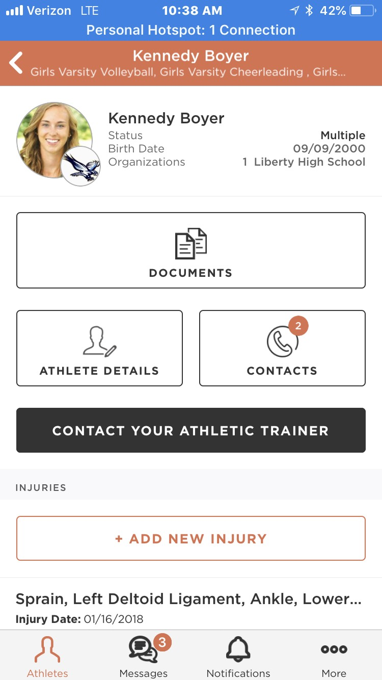
Healthy Roster for Parents
Invite only App -FREE
Access to your athlete’s records
Get alerts when injuries occur
Send messages to your Athletic Trainer
Upload documents
Care team receives same information
Injury Timeline
Notes:
App usage is free to parents, coaches and schools
All Athletic injury records stored in one place
Athletic trainer can send you an alert when an injury occurs
Can communicate directly with athletic trainer through the app
Can upload documents like the Impact permission slip or a MD note
You designate the care team- Coach, school nurse, other parent. When alert is sent all parties receive the same information. Will reduce communication errors.
Injury Timeline houses the conversations about an injury between all parties

Slide 9
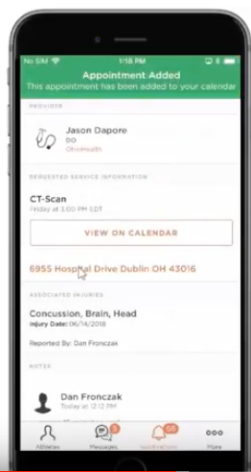
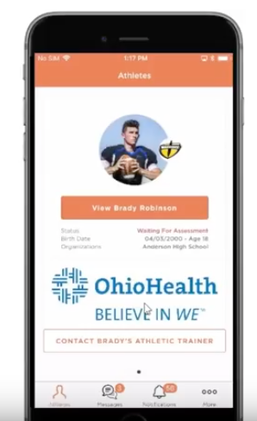
Follow up Services
Referral Information right at your fingertips

Slide 10
How do you sign up?
Wait for your personal invite
Install the Healthy Roster APP
Watch a demonstration video on how to get started
Create your athletes profile

Slide 11
SMSA Athletic Boosters
Booster Club President: Chris Holmes
Booster Club Meetings: 6 pm, 2nd Wed. of the Month
Sport Passes:
Adults - $50.00 each
Senior Citizens (62 & Older) - $25 each
Springs students will be allowed in free to all games.

Slide 12
SMSA Athletic Booster Club
What is ABC about: Raising Funds to help support, maintain and promote athletes and programs by providing:
Uniforms Equipment Locker room projects Video | Fan busses Concession improvements Scholarships and much more.
ABC supports over 46 athletic programs from Pre-K through 12 that engage more than 80% of our students.
Booster Officers
President: Chris Holmes
Vice President: Tom McGuire
Treasurer: Isaac Mueller
Secretary: Rob Hyland
Athletic Director: Greg Hoffmann
Concessions Director: Jackie Konkol
Trustee: Lisa Krusick, Shawn Longley,
Rob Hyland, Jackie Konkol, Jeff Coon,
Jim Baudry , Zach Wilderman
ABC MEETINGS HELD SECOND WEDNESDAY OF EACH MONTH | CAFETERIA | 6:00 PM

Slide 13
SMSA Athletic Booster Club
Where does ABC assist:
Uniforms at all levels to represent our school and faith
Equipment to properly train our athletes and provide the best protection during competition
Special Projects that do not fit in the normal Athletic Budget
Big Investments
Marian Field Project
Girls Softball – Jerseys / Equipment
Middle School FB – Helmets
Boys HS Basketball- V & JV uniforms
Fan Buses
Boys Baseball – Equipment & Uniforms
ABC Scholarships
ABC MEETINGS HELD SECOND WEDNESDAY OF EACH MONTH | CAFETERIA | 6:00 PM

Slide 14
SMSA Athletic Booster Club
To Join Concessions Stand Team Contact
Jackie Konkol
jkonkol@execfs.com
Current Captains:
WE NEED YOU!
Parent involvement is essential for a successful club
Financial Support
Friend of the Ledgers!!!! #1 funding event for ABC
Season Passes Will be sold at Fall Sporting Events
Volunteers Needed - Concessions stands
Great Opportunity to meet other families
Service to all those attending
Funds the activities to support our teams
ABC MEETINGS HELD SECOND WEDNESDAY OF EACH MONTH | CAFETERIA | 6:00 PM

Slide 15
Booster Club – Concessions & Admissions
We need your help. Please send me an email (jkonkol@execfs.com) and let me know if you would like to help and I will add you to a team.
We will have 8 -10 teams of 10-12 people per team.
These teams will cover the concessions and admissions for Varsity Football, Volleyball, Girls’ & Boys’ Basketball
Each team has a captain
Each team will cover a total of approximately 4 events for the entire year.

Slide 16
Be the Parent Who is Part of Their Good Athletic Memories
Release your child to the whole experience as soon as possible (Releasing is trusting their athletic destiny to them instead of trying to control it)
Model behaviors we expect them to exemplify
Be aware of your words, reactions and body language (There is a fine line between involvement and interference, and between encouragement and pressure)
Stop hovering and wanting everything to go perfectly (The less you give advice, the more likely they are to ask for it)
Four roles – you can only be one (Players, coaches, spectators, and officials) (Proactive Coaching by Bruce Brown)

Slide 17
Channel of Communication
Athletes & Parents
Head Coach of your Team
Head Coach of your Sport
Athletic Director – Greg Hoffmann
Principal – Eamonn O’Keeffe
SMSA President – Stacey Akey

Slide 18
Students
“Roles” of SMSA Athletics
Cheer for our teams and not against our opponents.
Be respectful of the National Anthem.
Be a model of good sportsmanship.
Pick up garbage after game. (Home and Away)
Social Media

Slide 19
Please read the following before signing the forms!
2022-2023 Co-Curricular Handbook
WIAA 2022-2023 WIAA Rules of Eligibility (HS Only)
Parents Who Provide Good Athletic Memories
WIAA Concussion/Sudden Cardiac Arrest Information
(These can all be found on the bottom of the Athletics Page on the Springs website.)

Slide 20
Co-Curricular Code of Conduct Handbook
1) Purpose of the athletic program (pp. 1-2)
- Vision, Mission, and Core Values (Faith, Learning, Respect, Leadership, Community, Responsibility)
Objectives – Provide an opportunity for spiritual, academic, physical and emotional growth
2) Academic Standards (pp. 4-5)

Slide 21
Academic Ineligibility
Must pass ALL classes
With an incomplete grade, the student is still eligible, unless the incomplete turns into a failure
Ineligibility period
Progress 1, 1st quarter, Progress 2, 2nd Quarter, Progress 3,
3rd Quarter & Progress 4 - 8 school days for an F in one class, 15 school days if you receive an F in two or more classes.
4th quarter - 21 days from the first legal day of a game/match or one-third of the fall season, per WIAA guidelines (the 4th quarter ineligibility period will be served in the Fall)
Students that are ineligible will not be dismissed early from classes.

Slide 22
Co-Curricular Code of Conduct Handbook
3) Description of Co-curricular Code Violations and Consequences (pp. 6-10)
Type I Violations
Type II Violations
Type III Violations
4) Reporting violations, Violation Review, and Appeal Process (pp. 10-13)
5) Additional Co-Curricular Guidelines (pp. 13-14)
Equipment/Uniforms, Insurance, Travel, Vacations, Single Sport, Open gyms.

Slide 23
WIAA Athletic Eligibility Information
The purpose of the WIAA Athletic Eligibility Bulletin is to summarize the WIAA Official Handbook.
Topics discussed include:
Attendance (must be enrolled as a full time student),
Determining Residence and Transfers (transferring schools may result in restrictions on eligibility),
Training and Conduct (speaks to: abiding by school’s Code of Conduct, disqualification from a contest for flagrant or unsportsmanlike conduct, and conduct toward officials.)
Amateur Status (may not accept cash for athletic accomplishments, may not receive compensation for use of name, picture, etc. for athletic performance, may not provide endorsement in the promotion of an advertisement and/or profit making event.
Sports Activities Outside of School (athletes may compete in not more than two non-school competitions with school approval during each regular sport season)

Slide 24
Concussion/Sudden Cardiac Arrest Information
Please take the time to read the documents about Concussion and Head Injury as well as Sudden Cardiac Information.
It is extremely important to educate yourselves on these particularly important topics. If you ever have any questions concerning concussions or sudden cardiac arrest, please contact our trainer Tyler Schwarz. He should always be the first step in determining whether the athlete has a concussion.

Slide 25
Participation Requirements for SMSA Athletics The following must be completed before participating in practice:
Page 1 – Liability Waiver, Code of Conduct, WIAA Eligibility
Page 2 -WIAA Alternate Year or WIAA Physical Permit
Physical – Typically Grades 5, 7, 9, 11
Alternate Year–Typically Grades 6, 8, 10, 12
Page 3 – Concussion/Sudden Cardiac Arrest Agreement Form
Page 4 – Medical Information and Emergency Consent
(The next four slides show what these forms look like. These forms can be found on the bottom of the Athletics page of the Springs Website. Please return these forms as soon as possible. You can scan and email to ghoffmann@smsacademy.org, drop them off at school, or give them to your coaches at weight training or open gyms.)

Slide 26
Liability Wavier, Code of Conduct, WIAA Eligibility

Slide 27
WIAA Alternate Year or WIAA Physical Permit

Slide 28
Concussion/Sudden Cardiac Arrest Agreement Form

Slide 29
Medical Information and Emergency Consent

Slide 30
Schedules
Schedules can be found on the St. Mary’s Springs website on the Athletics page.
Click on Athletics Calendar
Features
1 – View Schedules – You can call up as many sports schedules as you would like and download them to your devices.
2 – Notify Me – You can set up an automatic notifications for whenever changes are made.

Slide 31
Fall Athletic Teams
Football – First Practice is August 2nd. Head Coach – Bob Hyland (hyland@charter.net)
Tennis – Practices begin August 9th. Head Coach – Breck Speers (speers@uwosh.edu)
Boys’ Soccer – Practices begin August 15th . Co-op team. Lead school is NFDL. Head Coach – Tony Denzin (tdenzin@nfdlschools.org)
Cross Country – Practices begin August 15th Head Coach – Teresa Van Horn (thvh88@aol.com)
Volleyball – Practices begin August 15th . Head Coach- Michelle Born (mborn@smsacademy.org)
Cheerleading –

Slide 32
Fall Athletic Teams - MS
5th Grade Football: Coach – Bill Everson (weverson@eversonandgibbs.com)
6th Grade Football: Coach – Dave Zangl (dkbzangl@gmail.com)
7th Grade Football: Coach – Chris Schneider(cschneider@smsacademy.org)
8th Grade Football: Coach – Jeff Coon (jeff@streamcreative.com)
7th Girls’ Basketball: Coach – Zach Pitz (Zachary.pitz@ssmhealth.com)
8th Girls’ Basketball: Coach – Todd Huempfner (toddhuempfner@atlasroofing.com)
6-8 Cross Country: Coach – Pete Vergos (pvergos@gmail.com)
5th Grade Volleyball: Coach – David Maruska (davidmaruska191@gmail.com)
6th Grade Volleyball: Coach – Jenny Schwarz (jlschwarz27@hotmail.com)
5-8 Cheerleading: Lindsey Kraig-Bembenista (kraigbembenistat@gmail.com), Gail Kraig (gailkraig@charter.net)

Slide 33
Greg Hoffmann – Athletic Director - SMSA
Email: ghoffmann@smsacademy.org
Cell phone: 920-602-5560
Work phone: 920-322-8067

